Slide 1
Are Sanctions Motivated by Protectionism?
Russell Bramblett
3 October 2017

Slide 2
Overview
This research attempts to answer the question, “are sanctions the U.S. imposes on foreign countries motivated by trade protectionism”?
Using sanctions votes in the U.S. House of Representatives from 2005-2015 and industry data within a given Congressional District, the empirical analysis indicates that with some types of sanctions bills and certain industries, Representatives’ votes may be affected by the prevalence of industries within their district.

Slide 3
Motivation
According to the GATT (General Agreement on Trade and Tariffs), the predecessor of the WTO (World Trade Organization), sanctions for “emergency purposes” is allowed. However, if it could be established that sanctions were not used for this reason but rather for protectionist purposes, affected countries could bring a case against the sanction’s sender
Most sanctions do not achieve the stated goal (see chart).
Chart based on data from Hufbauer et. al. (2007)

Slide 4
Recent Literature
Cameron, C., & Trivedi, P. (2009). Microeconometrics: Methods and Applications. New York: Cambridge University Press
Hufbauer, Gary; et al (2007). Economic Sanctions Reconsidered, 3rd edition.
This is a guide to what type of sanctions work based on 174 sanctions over the past century
Marinov, Nikolay (2005). Do Economic Sanctions Destabilize Country Leaders?
This is an empirical paper that describes variables that makes sanctions more or less successful.
Escriba-Folch, Abel (2012). Authoritarian Responses to Foreign Pressures. Spending, Repression, and sanctions.
The author of this paper details the cost benefit analysis performed by various regime types to determine whether they should change policies or not after a sanction has been implemented.
Peksen, Dursun (2009). Better or worse? The Effect of Economic Sanctions on Human Rights.
This article looks at the human rights effects of the sanctions and falls in line with the authoritarian response paper.
Ang, Adrian; Peksen, Dursun (2007). When Do Economic Sanctions Work? Asymmetric Perception, Issue Salience, and Outcomes.
In this paper, the authors assert that perception of the issue by both the sending and receiving countries will affect the outcome of the sanctions.
Davis, L., & Engerman, S. (2003). History Lesson, Sanctions: neither War not Peace. Journal of Economic Perspective, 187-197
Levy, P. (1999). Sanctions on South Africa: What did they do? AEA Papers and Proceeding

Slide 5
An Aside: Sanction in the U.S.
The Congress has a Constitutional responsibility to regulate trade.
The Export Administration Act of 1979 and the International Emergency Economic Powers Act of 1977 gave the President broad authority to levy sanction
A country can become the target of a sanction through legislation, executive order, or both
In the 2005-2015 timeframe sanctions through executive order make up about half of the total sanctions (16 Executive Orders; 14 Congressional Actions)
Chart based on data from Hufbauer et. al. (2007) and from original research

Slide 6
Sanctions Targets

Slide 7
Sanctions’ Success Factors
Relationship between target and sender
Political structure of the target country
Goal of the sanction
Hufbauer et al (2007)
Chart based on data from Hufbauer et. al. (2007)

Slide 8
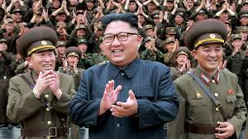
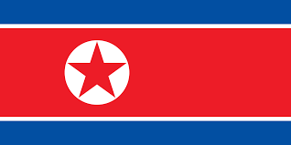
A Sanctions Case: North Korea
North Korean Characteristics
Political System: Dictatorship
Relations with U.S.: Antagonistic
Sanctions (from Congress):
2011
Stated Goal: Military Impairment
Sanctions Target: Imports/Exports and Financials
2016
Stated Goal: Military Impairment
Sanctions Target: Exports and Financials

Slide 9
Success Factors and North Korea
Success Factor | Success Rate
Military Impairment Against Dictatorship | 37%
Military Impairment with Antagonistic Relationship | 40%
Sanctions on Exports and Financials | 18%
Sanctions on Import, Exports and Financials | 40%
Chart based on data from Hufbauer et. al. (2007)

Slide 10
Methodology
Link votes to industries/occupations
This can be done by finding occupation data that is divided by congressional district and linking votes to those districts
Turn the industry data into a location quotients
Account for other factors that would make a vote for or against a sanction “reasonable”
Literature, including Hufbauer et al (2007), have very specific recommendations for when to use sanctions.
There are other reasons to vote ‘yes’ or ‘no’ and these reasons are at least partially accounted for in the party voting variable
Using multinomial logit regressions to determine if prevalence of a given industry or occupation makes a Representative more or less likely to vote for a sanction

Slide 11
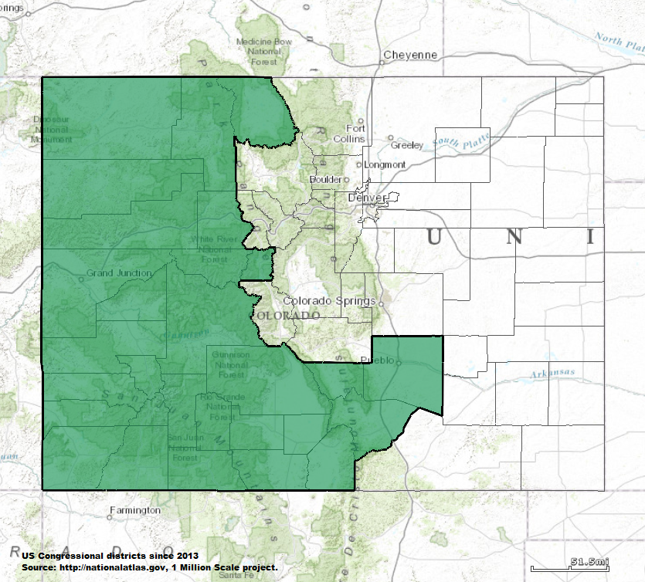

Congressional District Data
Occupation | Estimate
Civilian employed population 16 years and over | 346,147
Management, business, science, and arts occupations | 112,492
Service occupations | 73,872
Sales and office occupations | 81,671
Natural resources, construction, and maintenance occupations | 42,034
Production, transportation, and material moving occupations | 36,078
Industry | Estimate
Civilian employed population 16 years and over | 346,147
Agriculture, forestry, fishing and hunting, and mining | 13,133
Construction | 32,592
Manufacturing | 17,326
Wholesale trade | 8,233
Retail trade | 43,094
Transportation and warehousing, and utilities | 15,475
Information | 5,779
Finance and insurance, and real estate and rental and leasing | 18,971
Professional, scientific, and management, and administrative and waste management services | 33,370
Educational services, and health care and social assistance | 75,182
Arts, entertainment, and recreation, and accommodation and food services | 47,466
Other services, except public administration | 17,842
Public administration | 17,684
Scott Tipton
Source: American Community Survey

Slide 12
Location Quotients
Location Quotient: relative concentration of workers in an area
Industry | Estimate
Civilian employed population 16 years and over | 346,147
Agriculture, forestry, fishing and hunting, and mining | 13,133
Construction | 32,592
Manufacturing | 17,326
Wholesale trade | 8,233
Retail trade | 43,094
Transportation and warehousing, and utilities | 15,475
Information | 5,779
Finance and insurance, and real estate and rental and leasing | 18,971
Professional, scientific, and management, and administrative and waste management services | 33,370
Educational services, and health care and social assistance | 75,182
Arts, entertainment, and recreation, and accommodation and food services | 47,466
Other services, except public administration | 17,842
Public administration | 17,684
Estimate
100%
4%
9%
5%
2%
12%
4%
2%
5%
10%
22%
14%
5%
5%
Estimate
100%
2%
6%
10%
3%
12%
5%
2%
6%
11%
23%
10%
5%
5%
Estimate
1
1.82
1.49
0.48
0.87
1.07
0.90
0.79
0.86
0.89
0.94
1.39
1.05
1.08
Divided by national percent

Slide 13
Coefficient Expectations
Coefficients on the “yes” vote when the vote is to impose sanctions are expected to look as follows:
goalPC (political change in a country) – negative and significant;
goalMil (halt a country’s military adventurism) – positive and significant;
goalMI (curtail military capability) – positive and significant;
goalRC (change the political regime of a country) – negative and significant;
regime13 (regime type) - positive and significant;
relationsanc (prior relationship) - negative and significant.
voteWparty - positive and significant;
Coefficients on the “Not Voting” vote when the vote is to impose sanctions are expected to look as follows:
voteWparty - negative and significant.

Slide 14
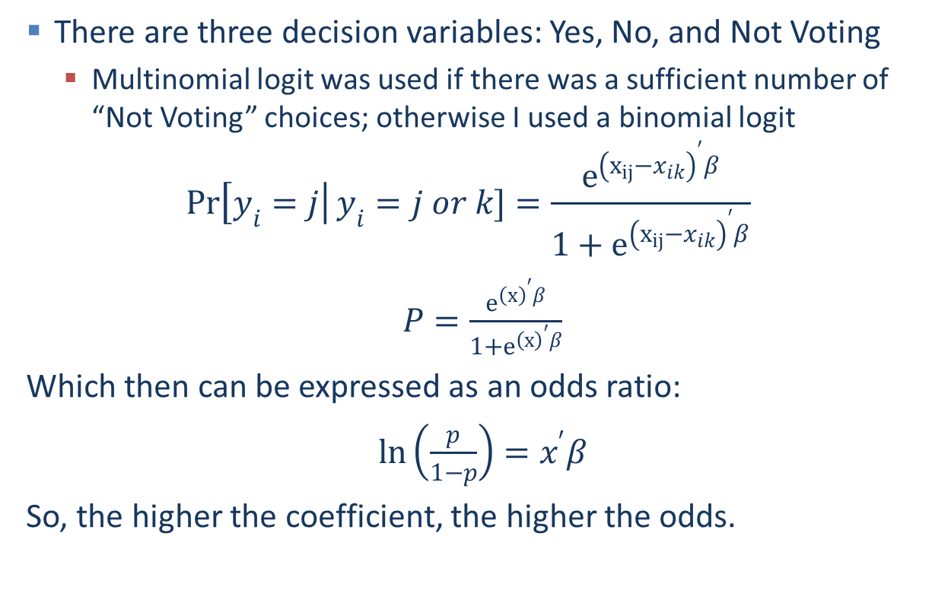
Model
There are three decision variables: Yes, No, and Not Voting
Multinomial logit was used if there was a sufficient number of “Not Voting” choices; otherwise I used a binomial logit
$$\operatorname{Pr}\left[y_{i}=j\right|y_{i}=j or k]=\frac{e^{{\left(x_{ij}−x_{ik}\right)}^{′}β}}{1+e^{{\left(x_{ij}−x_{ik}\right)}^{′}β}}$$
$P=\frac{e^{{\left(x\right)}^{′}β}}{1+e^{{\left(x\right)}^{′}β}}$
Which then can be expressed as an odds ratio:
$\ln\left(\frac{p}{1−p}\right)=x^{′}β$
So, the higher the coefficient, the higher the odds.
Notes:
Equations from (Cameron & Trivedi, 2009)

Slide 15
6.1. All Votes to Impose Sanctions
 | Effectiveness/Partisanship Only |  |  |  | Occupations |  |  |  | Industries
 | Not Voting |  | Yes |  | Not Voting |  | Yes |  | Not Voting |  | Yes
term | Coefficient |  | Coefficient |  | Coefficient |  | Coefficient |  | Coefficient |  | Coefficient
(Intercept) | 1.2 |  | -0.86 | ‡ | 12.55 |  | -5.99 | ‡ | -24.35 |  | -51.97 | ‡
goalPC | 1.65 | ‡ | -0.19 |  | 9.23 |  | -3.54 |  | -14.98 |  | -34.24 | ‡
goalRC | -3.93 | † | -7.22 |  | -3.91 |  | -8.02 |  | -3.89 |  | -8.15 | †
goalMil | -0.87 | ‡ | -0.15 | ‡ | -0.8 | ‡ | 0.06 | ‡ | -0.58 | ‡ | 0.06 | ‡
goalMI | -1.13 |  | -1.5 |  | 6.48 |  | -4.92 |  | -18.2 |  | -35.53
voteWparty | -6.6 | ‡ | 8.83 | ‡ | -6.72 |  | 10.21 |  | -7.98 |  | 10.27 | ‡
regime13 | -0.66 | ‡ | 0.08 | ‡ | -0.57 | ‡ | 0.09 | ‡ | -0.87 | ‡ | -0.2 | ‡
relationsanc | 1.87 |  | -0.04 |  | 9.39 |  | -3.52 |  | -15.52 | * | -34.17
MgtOcc |  |  |  |  | -10.97 |  | 2.48
ServOcc |  |  |  |  | -4.42 |  | -2.78
SalesOcc |  |  |  |  | -4.4 |  | 7.74
NROcc |  |  |  |  | -3.02 |  | 2.76 | *
TransOcc |  |  |  |  | -3.74 |  | 1.4
AgInd |  |  |  |  |  |  |  |  | 1.27 |  | 2.72 | †
ConInd |  |  |  |  |  |  |  |  | 4.17 |  | 8.15 | ‡
ManInd |  |  |  |  |  |  |  |  | 6.21 |  | 13.52 | ‡
WholeInd |  |  |  |  |  |  |  |  | 0.26 |  | 3.17 | ‡
RetInd |  |  |  |  |  |  |  |  | 7.91 |  | 18.19 | †
TransInd |  |  |  |  |  |  |  |  | 3.89 |  | 5.31 | ‡
InfoInd |  |  |  |  |  |  |  |  | 3 | * | 2.37 | †
FinInd |  |  |  |  |  |  |  |  | 5.87 | ‡ | 9.2 | †
ProfInd |  |  |  |  |  |  |  |  | 3.37 | * | 11.66 | ‡
EduInd |  |  |  |  |  |  |  |  | 11.02 |  | 23.68 | †
ArtsInd |  |  |  |  |  |  |  |  | 4.58 |  | 10.62 | †
ServInd |  |  |  |  |  |  |  |  | 5.82 |  | 4.34 | †
PubInd |  |  |  |  |  |  |  |  | 3.09 | † | 6.31 | *
 | Residual Deviance: 922.344 |  |  |  | Residual Deviance: 837.7225 |  |  |  | Residual Deviance: 800.1221
 | AIC: 950.344 |  |  |  | AIC: 885.7225 |  |  |  | AIC: 880.1221
‡ - Significant at 1%
† - Significant at 5%
* - Significant at 10%

Slide 16
6.2.1. Export Ban
 | Manufacturing Industry |  |  |  | Manufacturing Occupations |  |  |  | Wholesale Industry |  |  |  | Wholesale Occupations
 | Not Voting |  | Yes |  | Not Voting |  | Yes |  | Not Voting |  | Yes |  | Not Voting |  | Yes
 | Coef. |  | Coef. |  | Coef. |  | Coef. |  | Coef. |  | Coef. |  | Coef. |  | Coef.
Int. | -0.54 |  | -3.22 |  | -0.50 |  | -4.44 |  | -0.52 |  | -1.93 |  | -0.80 |  | -42.14 |  | ‡
goalMil | -0.88 |  | -0.80 |  | -1.15 | * | -0.85 |  | -0.90 |  | -1.02 |  | -0.88 |  | -18.22 |  | ‡
goalMI | -1.66 | ‡ | -6.82 |  | -1.84 | ‡ | -8.80 |  | -1.66 | ‡ | -5.65 |  | -1.88 | ‡ | -123.3 |  | ‡
votWpty | 71.72 | ‡ | 91.99 | ‡ | 81.85 | ‡ | 108.67 | ‡ | 70.88 | ‡ | 92.40 | ‡ | 83.48 | ‡ | 524.1
regime | -0.15 |  | -0.17 |  | -0.04 |  | -0.03 |  | -0.19 |  | -0.51 |  | -0.14 |  | 15.73
relation | 0.58 |  | 0.37 |  | 0.84 |  | -0.07 |  | 0.62 |  | 1.79 |  | 0.27 |  | 38.99
Man Ind | 0.30 |  | 0.11
Man Mgt |  |  |  |  | -0.72 |  | 0.03
Man Serv |  |  |  |  | -1.47 | † | -1.12
Man Sale |  |  |  |  | -0.35 |  | 4.64
Man NR |  |  |  |  | 0.00 |  | -4.32
Man Trans |  |  |  |  | 2.43 | † | 1.79
Whole Ind |  |  |  |  |  |  |  |  | 0.31 |  | -3.70
Whole Mgt |  |  |  |  |  |  |  |  |  |  |  |  | -1.10 |  | 141.13
Whole Serv |  |  |  |  |  |  |  |  |  |  |  |  | 0.41 |  | -18.93 |  | ‡
Whole Sales |  |  |  |  |  |  |  |  |  |  |  |  | 1.53 |  | -196.59 |  | ‡
Whole NR |  |  |  |  |  |  |  |  |  |  |  |  | -0.47 |  | -4.83 |  | ‡
Whole Trans |  |  |  |  |  |  |  |  |  |  |  |  | 0.42 |  | -3.75 |  | ‡
 | Residual Deviance: 164.0372 |  |  |  | Residual Deviance: 147.8479 |  |  |  | Residual Deviance: 163.7898 |  |  |  | Residual Deviance: 146.7042
 | AIC: 188.0372 |  |  |  | AIC: 187.8479 |  |  |  | AIC: 187.7898 |  |  |  | AIC: 186.7042

Slide 17
6.2.2. Import Ban
 | Manufacturing Industry |  |  |  |  | Manufacturing Occupations |  |  |  |  | Wholesale Industry |  |  |  |  | Wholesale Occupations
 | Not Voting |  | Yes |  |  | Not Voting |  | Yes |  |  | Not Voting |  | Yes |  |  | Not Voting |  | Yes
 | Coef. |  | Coef. |  |  | Coef. |  | Coef. |  |  | Coef. |  | Coef. |  |  | Coef. |  | Coef.
Int | 3.13 | ‡ | 0.79 |  | ‡ | 3.52 | ‡ | 0.70 |  | ‡ | 2.98 | ‡ | 0.85 |  | ‡ | 3.32 | ‡ | 0.75 |  | ‡
goalRC | -1.15 | † | -1.75 |  | ‡ | -1.36 | † | -1.76 |  | ‡ | -0.95 | * | -1.73 |  | ‡ | -0.94 | * | -1.75 |  | ‡
goalMil | 4.28 | ‡ | 2.53 |  | ‡ | 4.88 | ‡ | 2.45 |  | ‡ | 3.93 | ‡ | 2.59 |  | ‡ | 4.25 | ‡ | 2.50 |  | ‡
goalMI | -159.45 | ‡ | 1.48 |  | † | -148.81 | † | 1.59 |  | † | -180.74 | ‡ | 1.21 |  | * | -161.69 | ‡ | 1.52 |  | †
votWpty | 3.13 | ‡ | 0.79 |  | ‡ | 3.52 | ‡ | 0.70 |  | ‡ | 2.98 | ‡ | 0.85 |  | ‡ | 3.32 | ‡ | 0.75 |  | ‡
regime | 1.98 | ‡ | -0.96 |  | ‡ | 2.16 | † | -1.06 |  | ‡ | 2.04 | † | -0.88 |  | ‡ | 2.38 | † | -1.00 |  | ‡
relation | -1.39 |  | 0.84 |  | ‡
Man Ind |  |  |  |  |  | -2.57 |  | -0.14
Man Mgt |  |  |  |  |  | 1.54 |  | -0.04
Man Serv |  |  |  |  |  | 1.52 |  | 0.98 |  | †
Man Sale |  |  |  |  |  | -1.25 |  | 0.89 |  | ‡
Man NR |  |  |  |  |  | -1.87 |  | -0.53
Man Trans |  |  |  |  |  |  |  |  |  |  | -0.37 |  | 0.80 |  | †
Whole Ind |  |  |  |  |  |  |  |  |  |  |  |  |  |  |  | 0.58 |  | -0.15
Whole Mgt |  |  |  |  |  |  |  |  |  |  |  |  |  |  |  | -0.47 |  | -0.10
Whole Serv |  |  |  |  |  |  |  |  |  |  |  |  |  |  |  | -1.27 |  | 1.14 |  | †
Whole Sales |  |  |  |  |  |  |  |  |  |  |  |  |  |  |  | -0.98 |  | 0.46 |  | ‡
Whole NR |  |  |  |  |  |  |  |  |  |  |  |  |  |  |  | -0.31 |  | -0.38
 | Residual Deviance: 600.4848 |  |  |  |  | Residual Deviance: 585.2176 |  |  |  |  | Residual Deviance: 610.8899 |  |  |  |  | Residual Deviance: 594.8561
 | AIC: 616.4848 |  |  |  |  | AIC: 617.2176 |  |  |  |  | AIC: 626.8899 |  |  |  |  | AIC: 626.8561

Slide 18
Robustness Check
6.3.1. Trade Bills to Increase Trade
Bill | Vietnam Trade (2006) |  |  | Andean Trade Preference Act (2007) |  |  | Export Natural Gas (2014)
Variable | Coefficient |  |  | Coefficient |  |  |  | Coefficient
(Intercept) | 33.19 | * |  | -19.21 |  |  |  | -1.37
voteWparty | 25.36 | ‡ |  | 182.08 |  |  |  | 0.66
MgtOcc | -13.33 | † |  | -13.41 |  |  |  | 0.03
ServOcc | -8.73 | ‡ |  | 5.97 |  |  |  | -7.90
SalesOcc | -11.52 | † |  | -34.65 |  |  |  | 4.97
NROcc | -3.26 |  |  | 2.42 |  |  |  | 4.93
TransOcc | -7.80 | ‡ |  | -0.37 |  |  |  | -0.46
(Intercept) | -1.33 | ‡ |  | -75.05 |  |  |  | -0.54 | ‡
voteWparty | 25.52 | ‡ |  | 990.50 | ‡ |  |  | 1.01 | *
AgInd | 0.10 |  |  | -19.28 |  |  |  | 0.605 | ‡
ConInd | -0.79 |  |  | -99.22 |  |  |  | 1.98 | ‡
ManInd | -2.00 | ‡ |  | -83.94 | ‡ |  |  | 1.09 | ‡
WholeInd | 0.54 |  |  | 36.91 |  |  |  | -0.41
RetInd | -0.29 |  |  | -159.42 |  |  |  | 2.53 | †
TransInd | -2.09 | ‡ |  | -28.33 |  |  |  | -0.88 | *
InfoInd | 0.19 |  |  | 20.75 |  |  |  | -0.62
FinInd | -0.29 |  |  | -108.99 |  |  |  | 2.79 | ‡
ProfInd | -0.68 |  |  | -97.99 |  |  |  | -1.02
EduInd | -3.44 | ‡ |  | -108.30 |  |  |  | -3.91 | ‡
ArtsInd | -0.88 |  |  | 14.50 |  |  |  | -1.98 | ‡
ServInd | -0.59 |  |  | 46.88 |  |  |  | -0.93
PubInd | -0.07 |  |  | -48.12 |  |  |  | 1.25 | ‡

Slide 19
Robustness Check
6.3.2. Bills to Increase Trade w/o Natural Gas
Bills to Increase Trade
Variable | Coefficient | P-Value
(Intercept) | 32.80 | 0.10 | *
voteWparty | 25.65 | 0.00 | ‡
MgtOcc | -13.24 | 0.05 | †
ServOcc | -8.68 | 0.01 | †
SalesOcc | -11.46 | 0.03 | †
NROcc | -3.23 | 0.14
TransOcc | -7.78 | 0.01 | †
(Intercept) | -1.60 | 0.00 | ‡
voteWparty | 25.76 | 0.00 | ‡
AgInd | 0.11 | 0.57
ConInd | -0.78 | 0.21
ManInd | -1.99 | 0.00 | ‡
WholeInd | 0.55 | 0.48
RetInd | -0.27 | 0.86
TransInd | -2.08 | 0.00 | ‡
InfoInd | 0.20 | 0.71
FinInd | -0.28 | 0.74
ProfInd | -0.66 | 0.38
EduInd | -3.40 | 0.00 | ‡
ArtsInd | -0.87 | 0.15
ServInd | -0.59 | 0.52
PubInd | -0.06 | 0.87
The natural gas regression is a bit more complex than the others to interpret
Some industries would prefer to export their products, other industries would prefer to have lower gas prices.

Slide 20
Conclusion
Are sanctions motivated by trade protectionism? Probably. Constituency explains much of the voting behavior.
This sanctions voting behavior clearly violated the intent of the WTO and quite possibly the actual agreements. Many of the states sanctioned are not yet members of the WTO (i.e. Syria, Iran, Libya, Sudan, North Korea), but Burma is. In the case of Burma, the stated goal of the sanction was to change the regime, which the literature indicates will have the lowest probability of success. In addition, the Burmese sanction included an import ban, which shows strong correlation in the data to voting based on industry density. So, while many countries may be the target of sanctions for protectionist reasons, Burma is one of the few that, based on its accession to the WTO and this analysis, might have standing to make a case to the WTO about being unfairly targeted by protectionist policies.

